Slide 1
FlexBox and Grid
CTEC 130

Slide 2
FlexBox

Slide 3
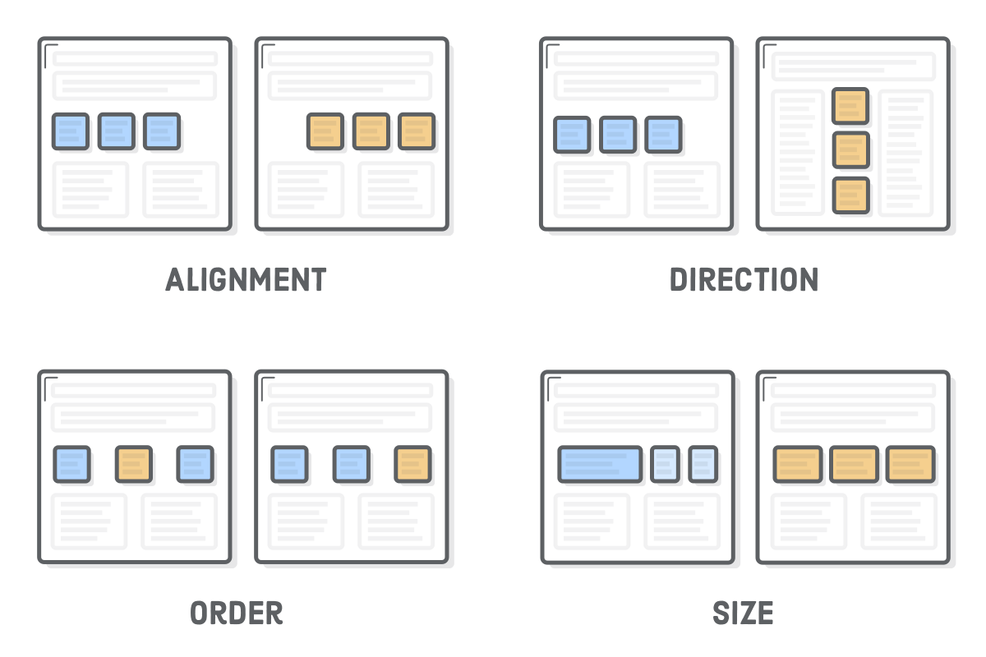
Flexbox vs Floats
Floats set horizontal position of elements in a document while letting the “flow” control vertical positioning
Flexbox provides complete control over a set of elements

Slide 4
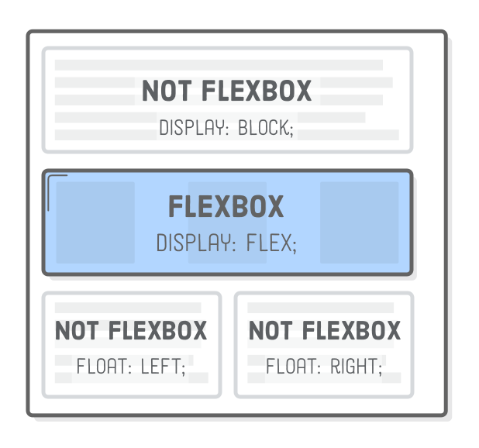
Containers and Items
To layout items within a FlexBox layout, you must put them inside of a Flex container
Some parent element with its display: flex;
With a parent set to flex, it’s children will display as flex items positioned by the flex rules

Slide 5
Flex Container Properties

Slide 6
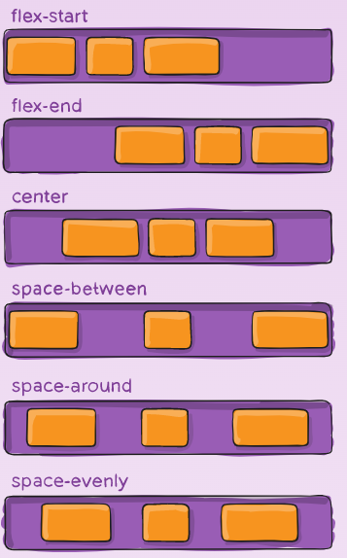
Alignment
Set on the justify-content property
Possible Values:
center
flex-start
flex-end
space-around
space-between

Slide 7
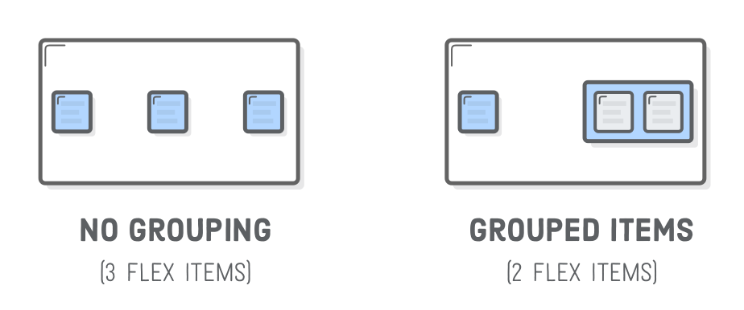
FlexBox and Nested Items
Each element inside of a Flex container is displayed as a Flex item
Elements inside of a Flex Item are displayed based on their own display settings
A Flex Item can also be a Flex Container

Slide 8
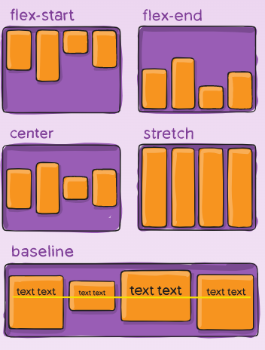
Vertical Alignment
Set on the align-items property
Possible Values:
center
flex-start
flex-end
stretch
baseline

Slide 9
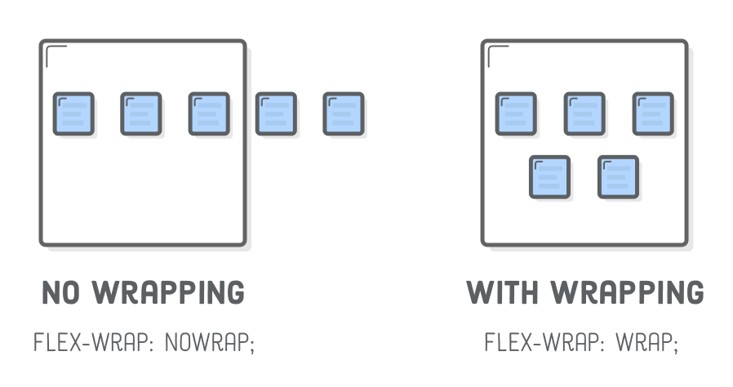
Wrapping
Set on the flex-wrap property
Possible Values
wrap
nowrap
wrap-reverse

Slide 10
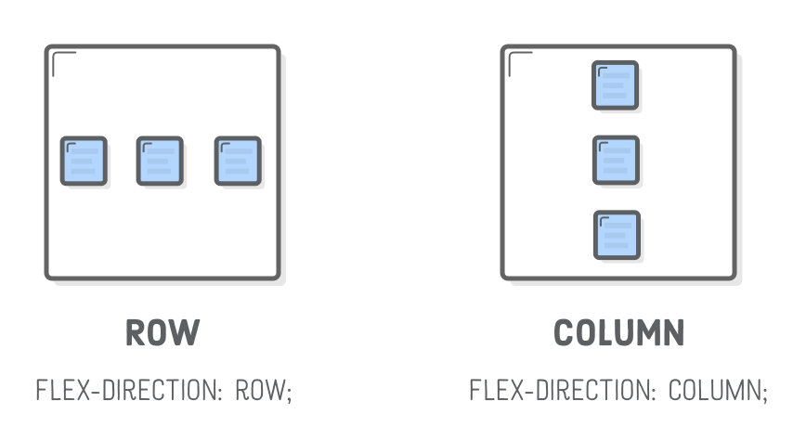
Direction
Set on the flex-direction property
Makes each item appear either left-to-right or top-to-bottom
Possible Values:
row
column
row-reverse
column-reverse

Slide 11
Flex Item Properties

Slide 12
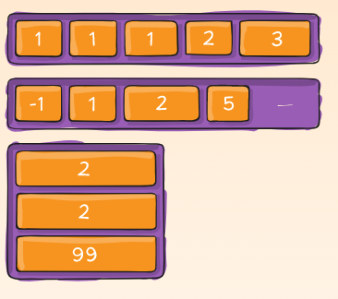
Flex Item Order
The previous properties apply to the Flex Container, while this one applies to a specific Flex Item
The order: property defines the order that each item appears
Higher values appear later
Earlier values appear first
You can enter negative values

Slide 13
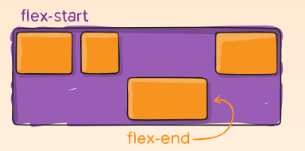
Align-Self
The align-self property allows you to override the container’s align property for a single flex item
Has the same possible values as align-items

Slide 14
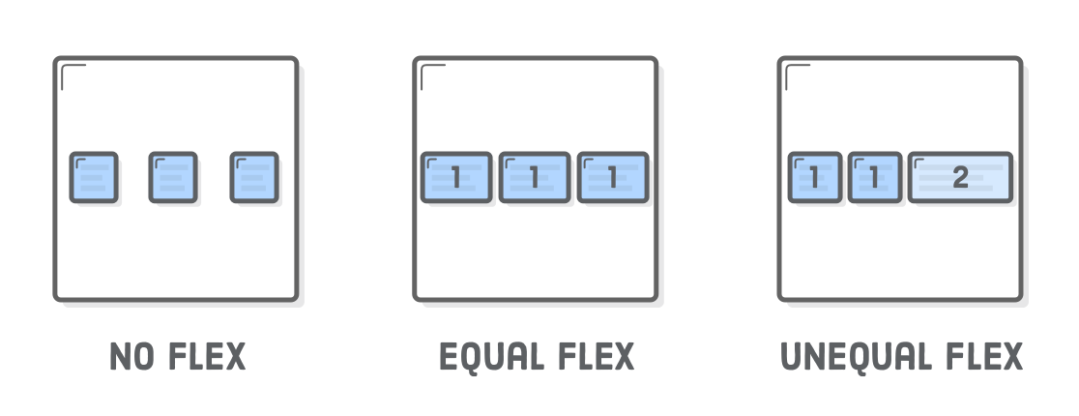
Flex
The flex property tells an item how much space to take up within its container
You can think of it as how many “slices” of the area each item takes up
Flex is not on by default, and you can set a flex of “initial” to set the item width directly

Slide 15
More Flex
You can create more specific flex scenarios with the following properties:
flex-grow
The maximum space for an element to “grow” to fill
flex-shrink
The minimum space for an element to shrink to
These values take proportions just like flex
These properties aren’t useful on pages of specific sizes, but will become very useful when we start working on responsive layouts

Slide 16
Margins and Flex Items
If you set a margin for a Flex Item to “auto,” this will create a margin that spans the entire empty area of the container
This can be used to space out items on the left and right side of a container

Slide 17
SubMenus

Slide 18
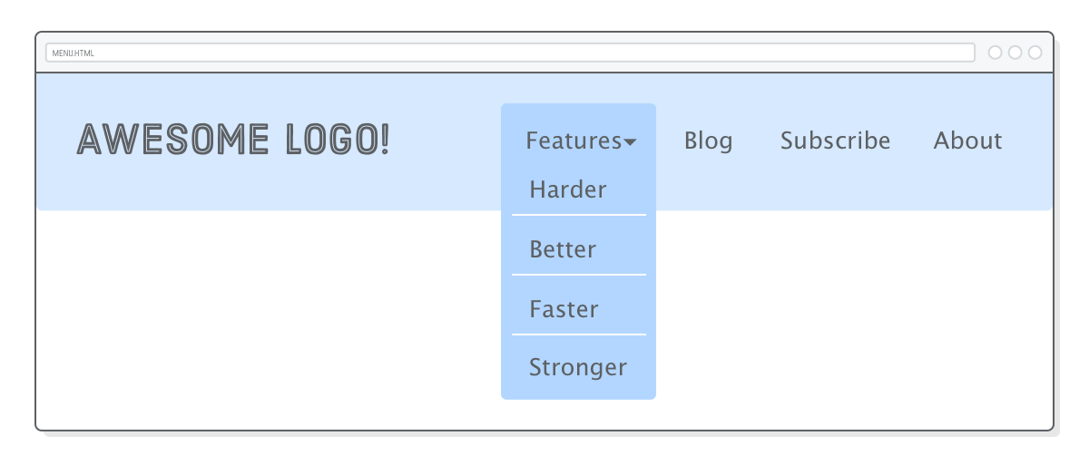
Menu Tricks
You can use a combination of positioning, pseudo-elements and display settings to create css drop-down menus
There are several guides on this, but let’s just make one ourselves

Slide 19
Grid

Slide 20
More CSS History
As CSS became more powerful and popular, different frameworks were developed for it
These frameworks usually tried to eliminate the basic “boilerplate” code that was created when users created new sites and unify layouts
A popular type of framework from back in the day was the “grid” framework, which broke down the layout of a page into a series of columns from which content might start
As always, new CSS features eventually absorb the design trends of 10 years ago, so now we have the Grid property

Slide 21
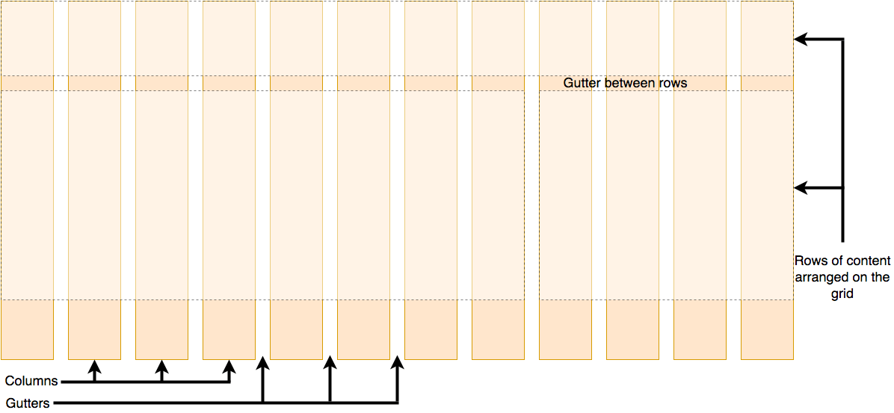
Grid Layout

Slide 22
Two Ways to think about Grid Layout
As a guide for content to expand through
As a block space for content to exist within

Slide 23
The Grid Container
Like with Flex, we set a container’s display property to grid to force all inner items within the grid display
We can define properties for the full grid layout on the container, then set specific values on each item to define how they exist within the container

Slide 24
Grid Container Properties
grid-template-columns
Sets the amount and width of each column
200px 200px 200px; - would set 3 200px columns
1fr 1fr 2fr 1fr; - would set 4 columns with the second to last being double width
grid-template-rows
Like columns, but for the amount of rows
gap
Sets the gap width between columns, can’t be an fr
grid-auto-columns
Sets the limits on automatically generated columns
grid-auto-rows
Sets the limits on automatically generated rows

Slide 25
Explicit and Implicit Grid
When you define template values, you’re defining an explicit grid
If you define explicit columns, the rows are set implicitly
Possibly via the grid-auto-rows properties
This is generally how Grids are used for layout

Slide 26
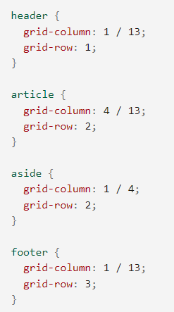
Line-Based Placement
Once you’ve set up a grid, you can use different properties on Grid Items to state exactly where in the grid they display and how many grid-lengths they last

Slide 27
Some Useful CSS Functions
repeat()
Allows you to set a rule multiple times without typing it out
grid-template-columns: repeat(12, 1fr);
Creates a 12 column grid
minmax()
Allows you to set the minimum and maximum values for a grid item
grid-auto-rows: minmax(100px, auto);
Creates grid rows which are as tall as they need to be, but can’t be smaller than 100px tall

